Slide 1
2019

Slide 2
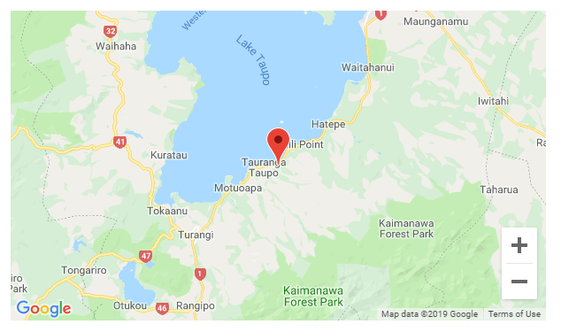
MiCamp Taupo is surrounded by a tranquil native bush setting a very short walk from the edge of The Great Lake, 30 minutes south of Taupo township. There are many exciting activities available at MiCamp Taupo. We have programmes that include physical challenges, life skills, leadership development and outdoor education programmes that promote an appreciation of the natural NZ environment surrounding our camp.

Slide 4
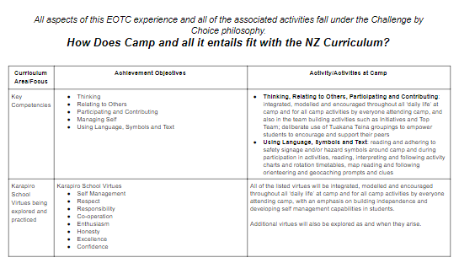

Slide 5
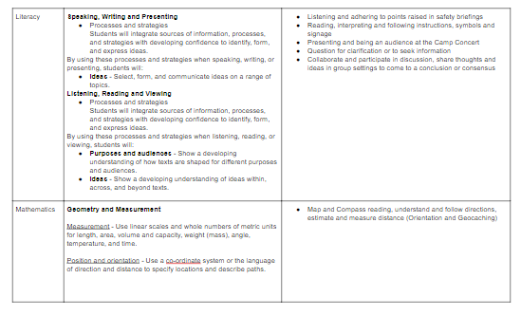

Slide 6
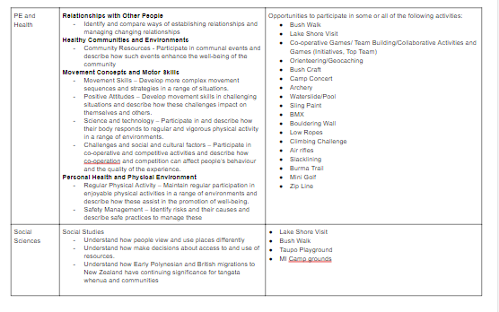

Slide 7
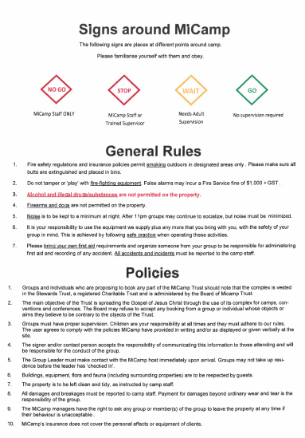

Slide 8
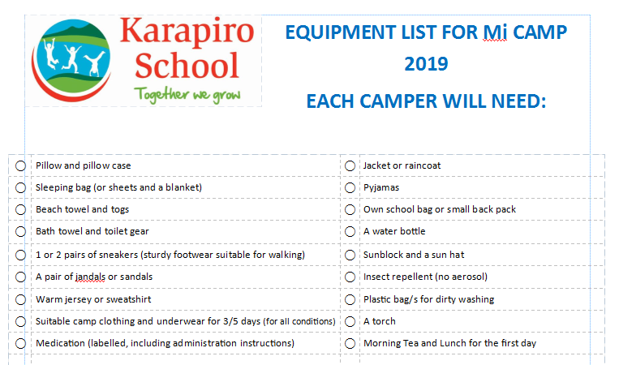

Slide 9
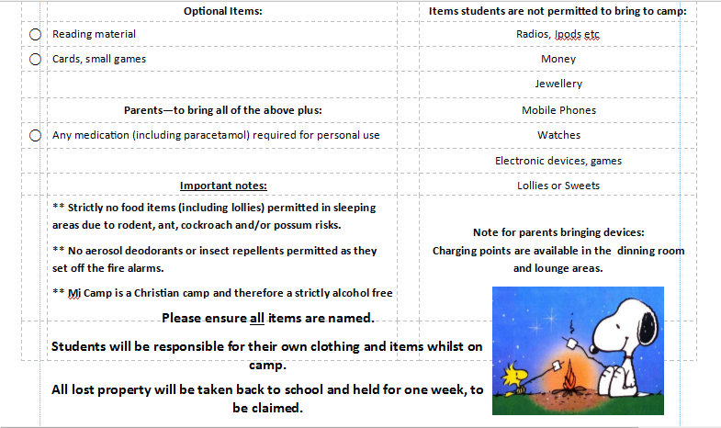

Slide 10
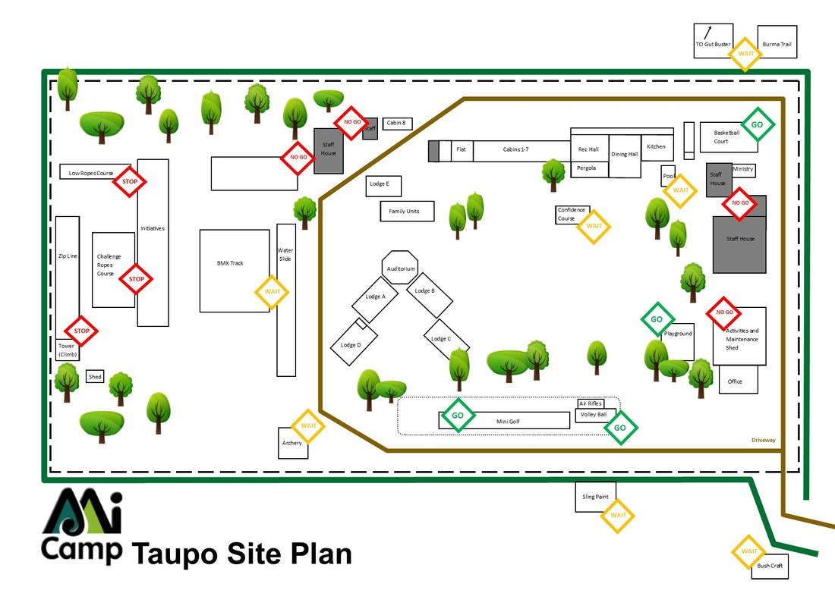
MAP OF CAMP

Slide 11
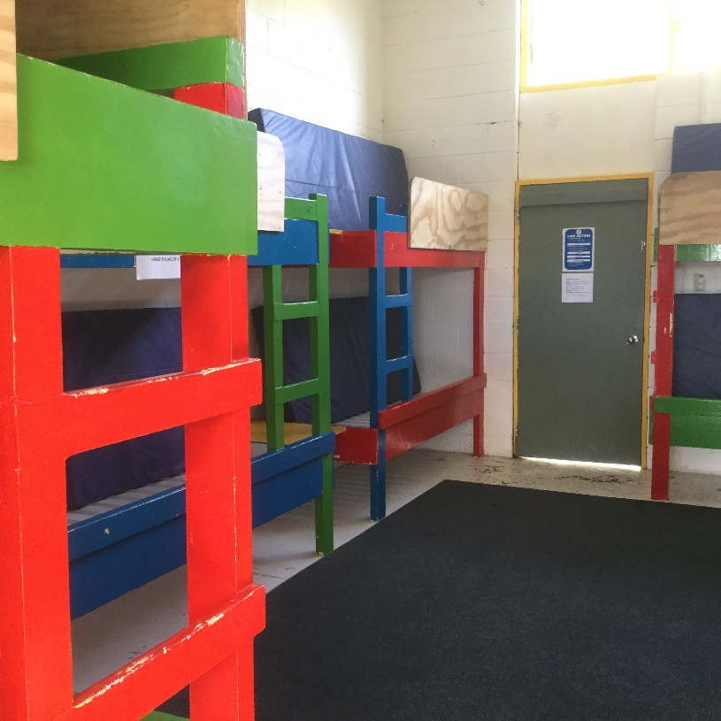
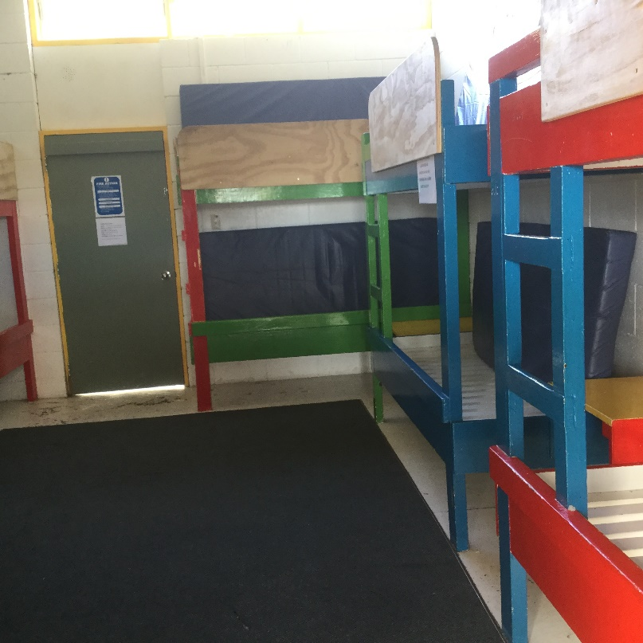
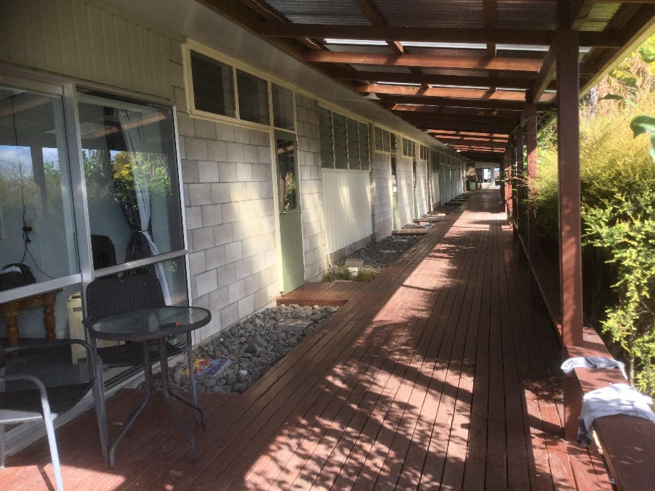

Slide 12
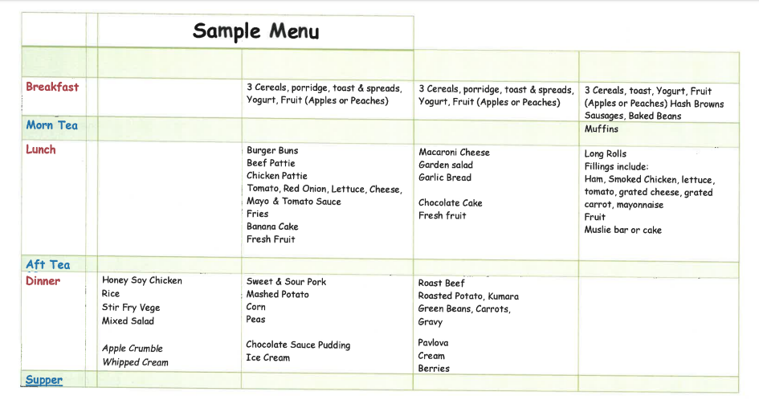
Menu

Slide 13
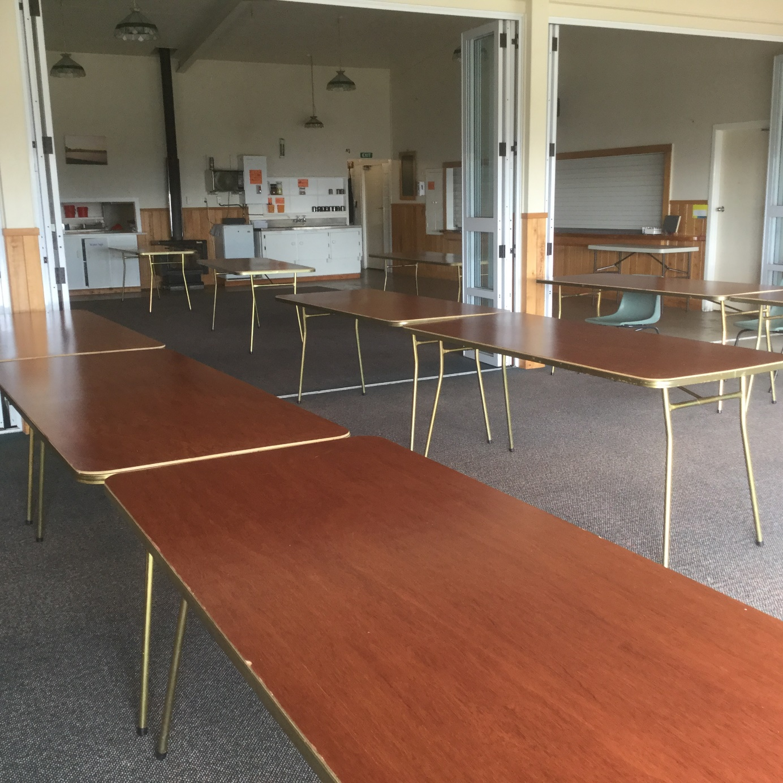

Slide 14
Time | Monday, 18 November
8.00 am | Breakfast at home
9.00 am - 9.30am | Roll, Packing vehicles, ready to leave school at 9.30am
9.30am to 11.00 am | Travelling to Taupo Public Playground, 4 Story Place (Travel time approx 1 hour 30 min)
11:30 am | Morning Tea (provided from home) @ Taupo Public Playground
12.10 pm to 12.45 pm | Travel from Taupo Public Playground to MI Camp 100 Rawhira Road, Waitetoko Beach, Taupo (Travel time approx 35 minutes)
12.45 pm to 2.30pm | Arrive at MI Camp, Safety Briefing for every student, parent and teacher. Unpack, make beds have Lunch (provided from home)
Junior Students will travel to and from camp with Junior Camp Parent Helpers, Senior Students will travel to and from camp with Senior Camp Parent Helpers – closer to the time transport lists will be made and distributed
It is essential that we all stick to travel/meeting times as roll calls will be made at each stop
It is a Mi Camp requirement that all students and adults attend the safety briefing on arrival
Sleeping/cabin maps will be provided closer to the time. It is an Mi Camp health and safety requirement that all children and adults are required to sleep in the cabin/bed they have been allocated, we are not permitted to move or change beds.

Slide 15
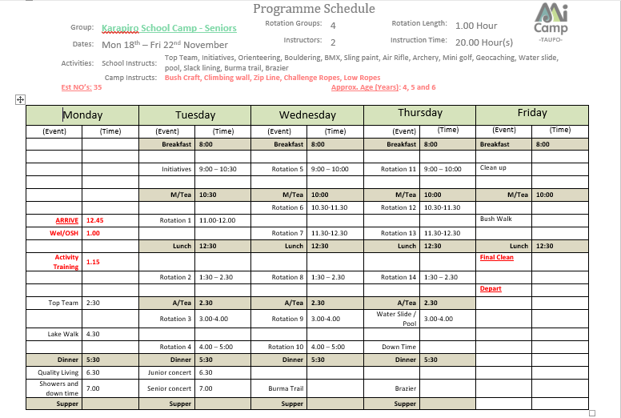

Slide 16
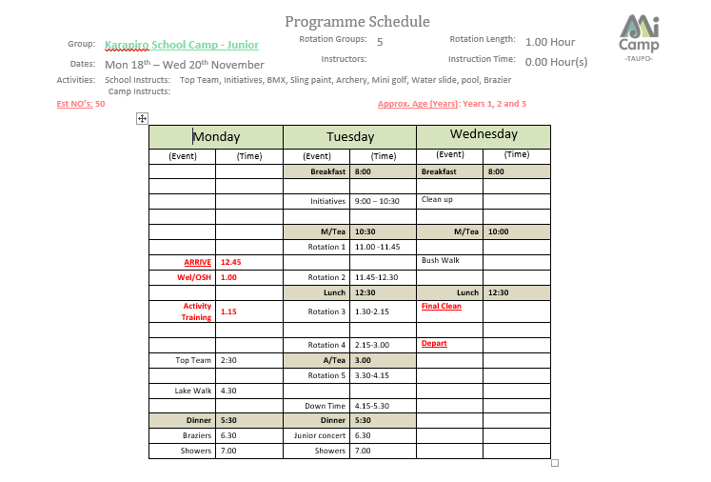

Slide 17
Activities
All activities will be held onsite. The one exception is our walk to the lake front, which is approximately 300m away from camp.
MiCamp provide all equipment and instructions for all activities
Some activities will be run by parents and those requiring instructors will be run by fully qualified instructors
Students will be put into two different groups – a Tuakana Teina group (where juniors and seniors are grouped together for activities like Initiatives and Top Team) and an Activity group for other junior/senior activities
Parents will not be allocated to their own child’s group/s, however, when possible times may be arranged for parents to watch their own child/ren participate in activities with roaming staff and other parents covering their group while they go to watch
MiCamp provide all the safety documentation for every activity (SOP – Standard Operating Procedures)
All safety procedures and equipment at camp are audited annually

Slide 18
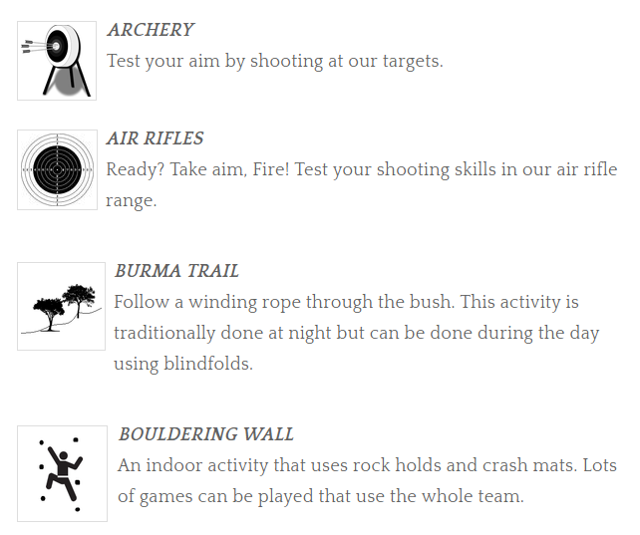
Activities
Juniors
Seniors
Seniors
Seniors
Seniors

Slide 19
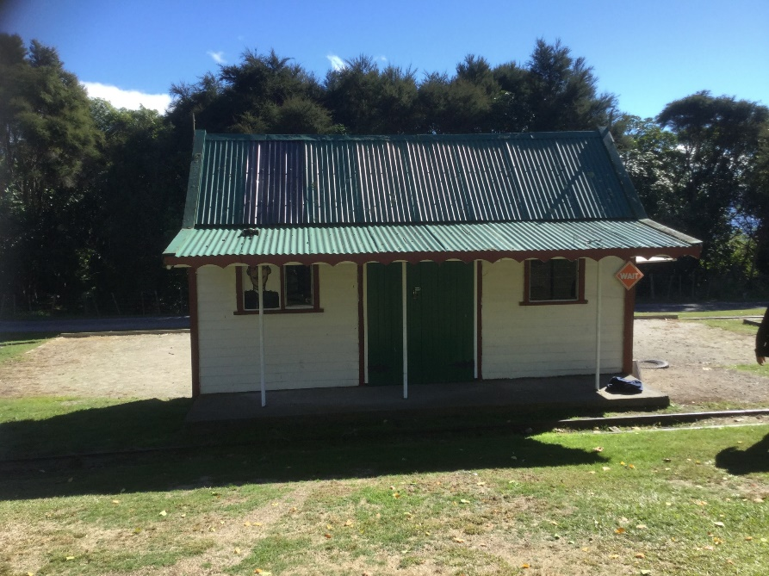
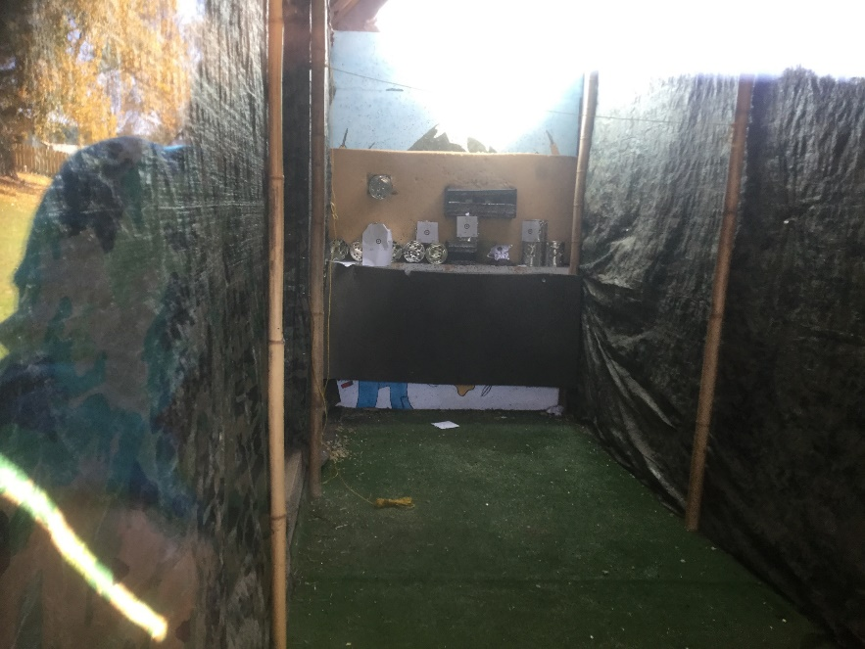
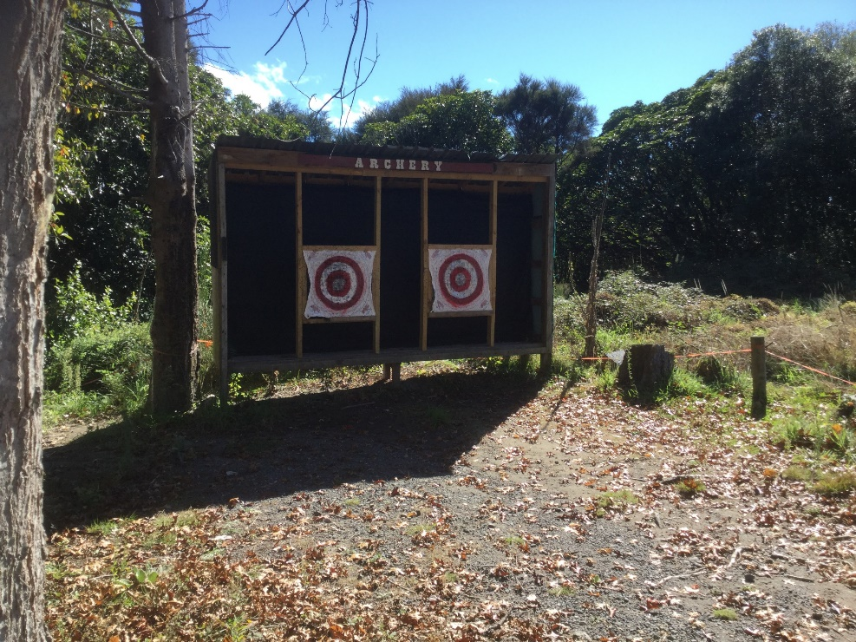

Slide 20
Juniors
Seniors
Seniors
Seniors
Juniors
Seniors

Slide 21
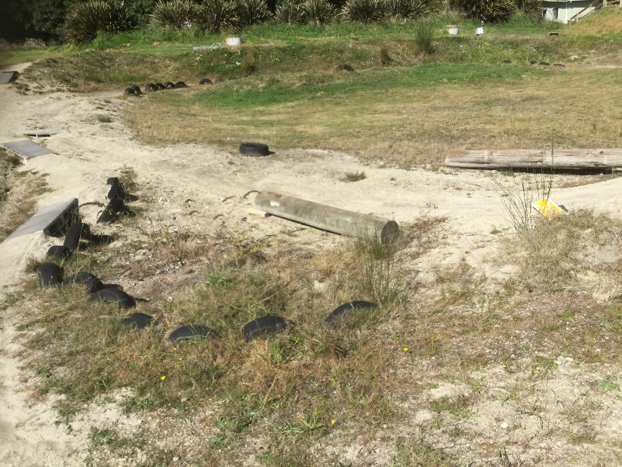
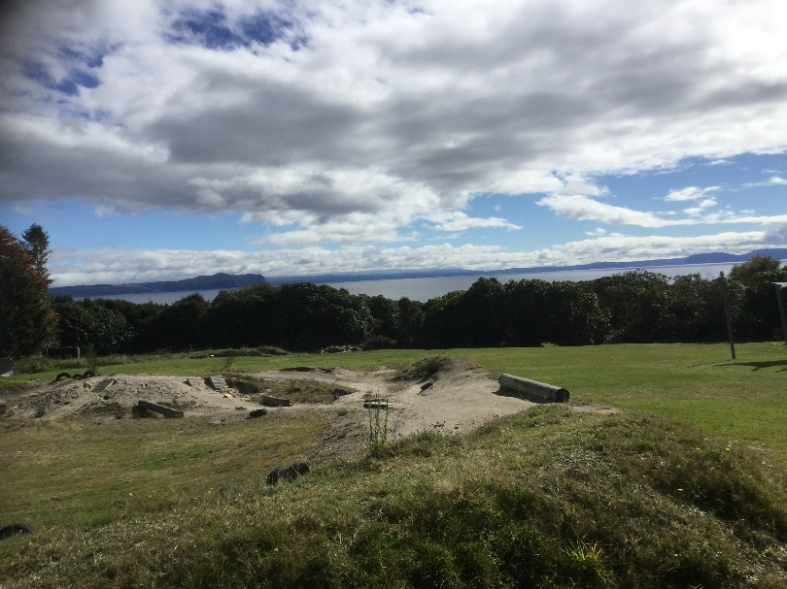
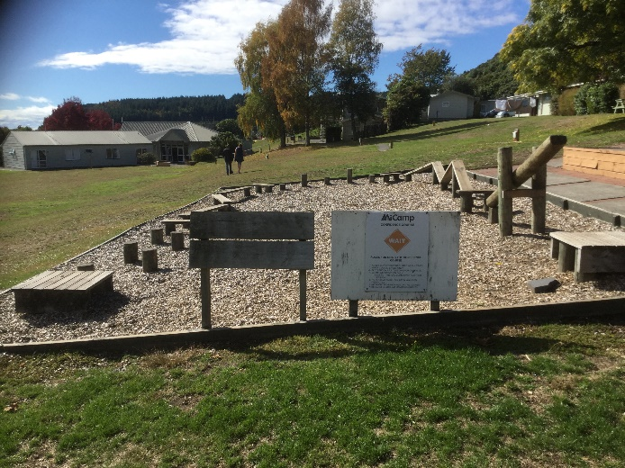
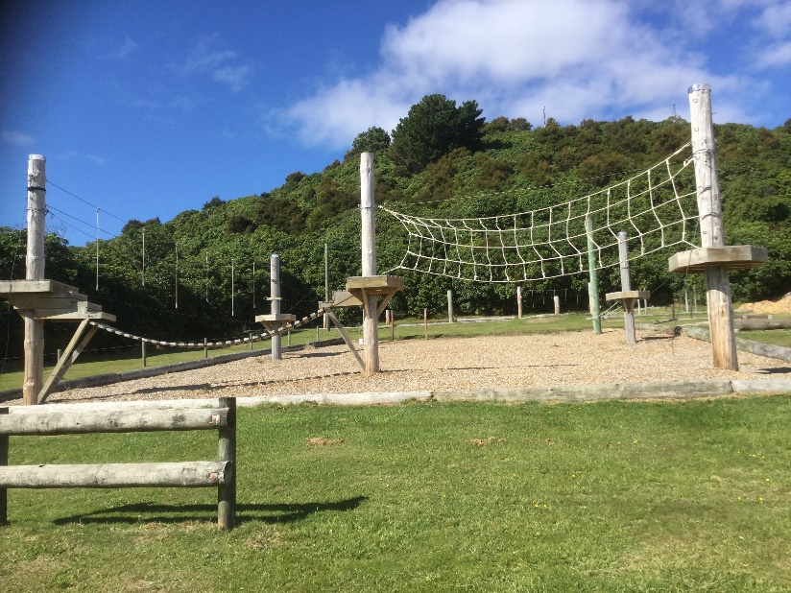
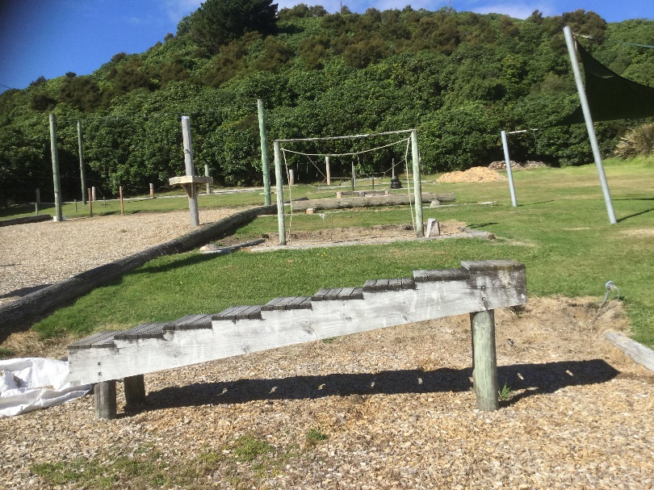

Slide 22
Seniors
Juniors
Seniors
Seniors
Juniors
Seniors

Slide 23
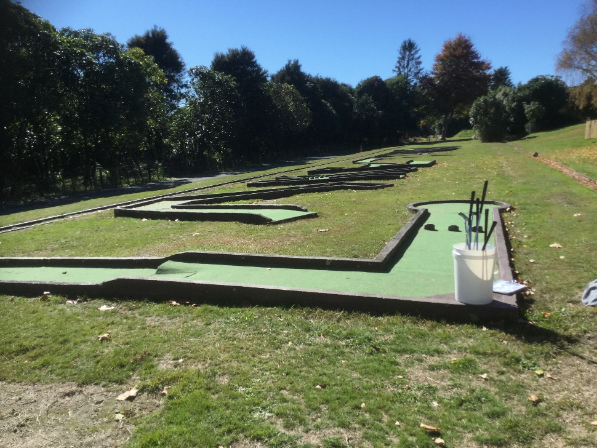
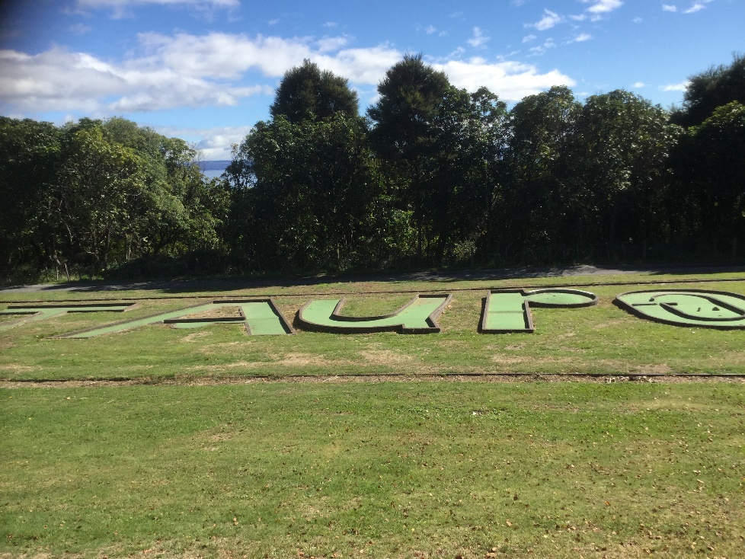
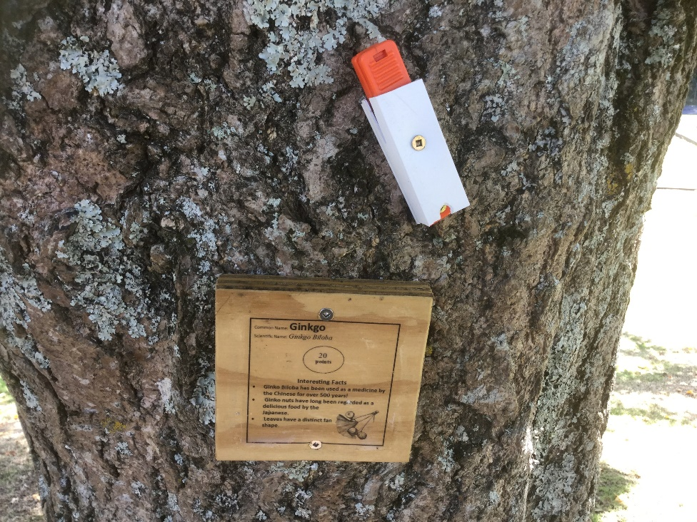

Slide 24
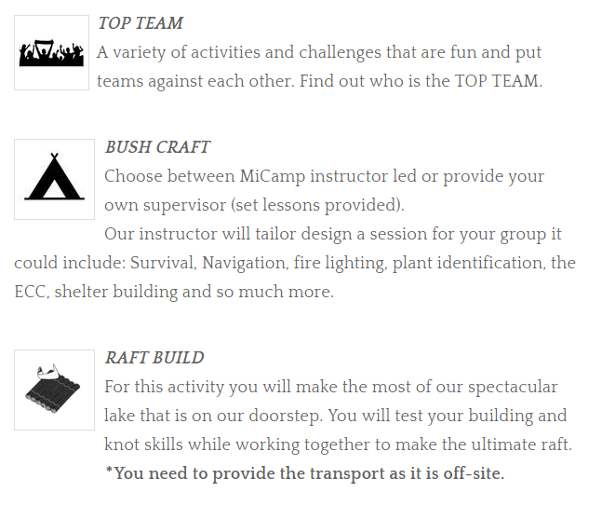
Juniors
Seniors
Seniors

Slide 25
Seniors
Seniors

Slide 26
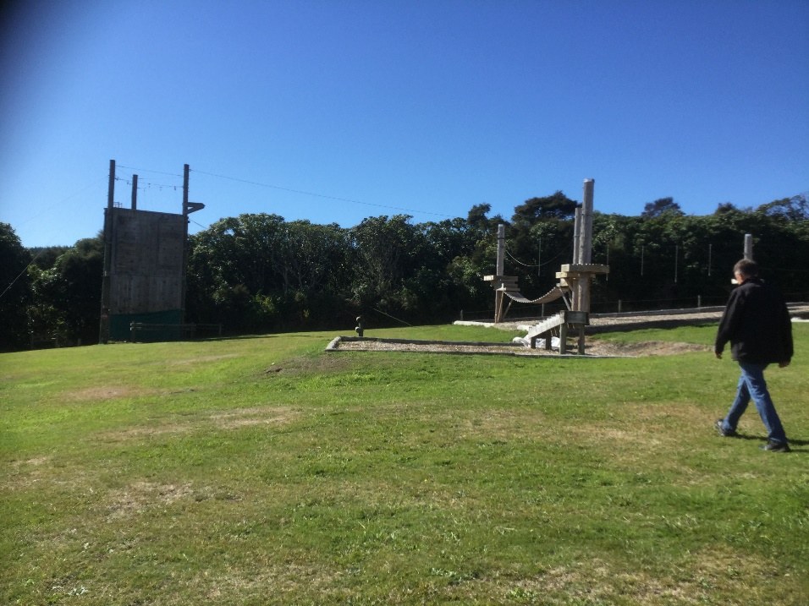
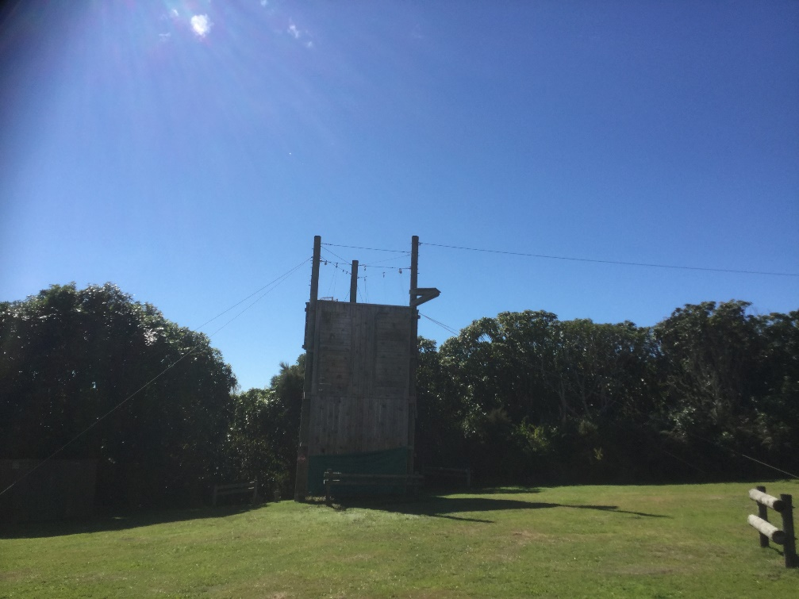

Slide 27
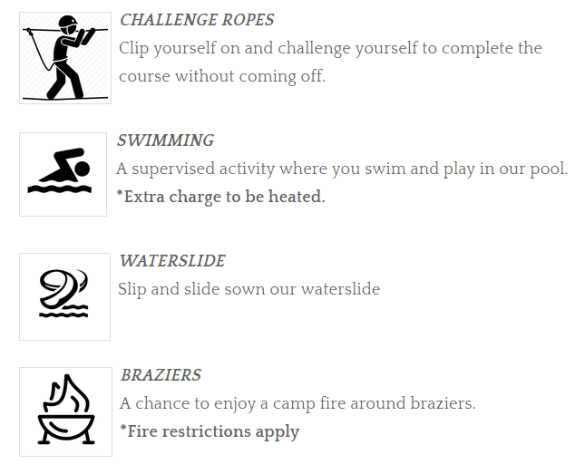
Seniors
Seniors
Juniors
Seniors
Juniors
Seniors

Slide 28
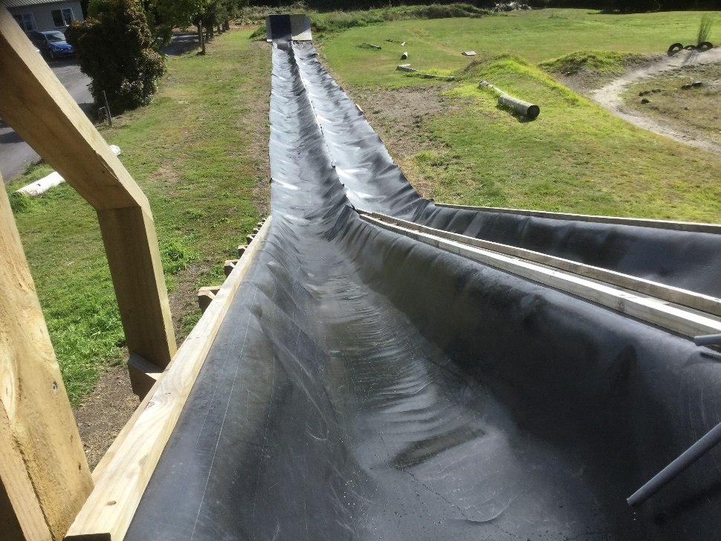
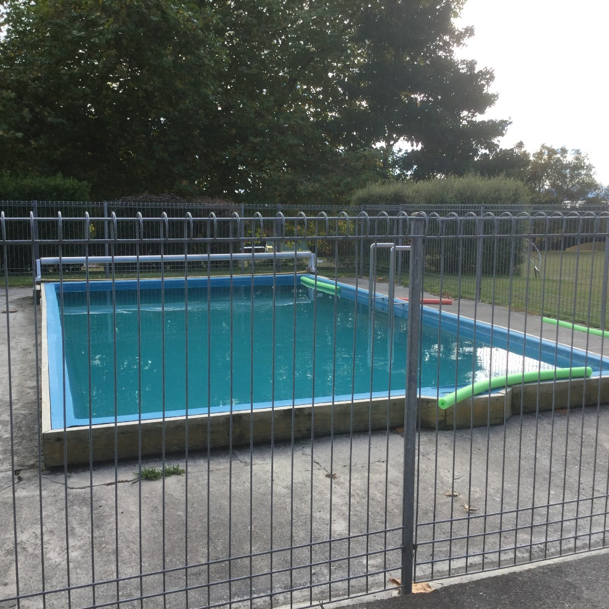
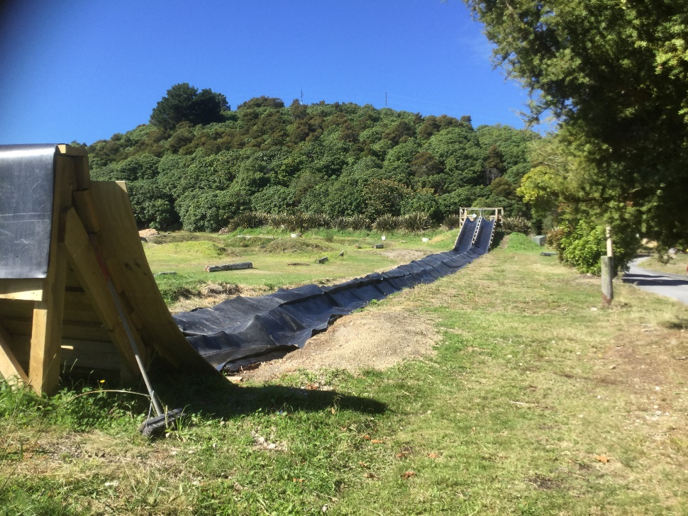

Slide 29
COSTS
All proceeds from the Rural School’s Cross Country Food Stall will go towards reducing camp costs for all students – The PTA will run this fundraising opportunity and will be calling on all attending families to support with this fundraising event
The PTA have been invited to look at other fundraising options also. If you have any ideas and/or contacts, please let Helen Duckworth know
All camp costs are expected to be paid prior to departure
Please see Sarah-Jane in the office, or Tina-Maree for any questions regarding payment options

Slide 30
Any Questions?
http://www.micamp.co.nz/lake-taupo.html
Early in Term 4 there will be a meeting for all parents who are attending camp. This meeting will outline everything they need to know about their role as Parent Volunteers.

